Slide 1
Notes:
Present Team name and project description

Slide 2





Slide 10
THE TEAM
Group Member
Group Member
Group Member
Team Lead
Charles Biggar
Don Leshem
Drew Seelig
Omar Eltorai
2
Notes:
Charles to present
“Ok so now that you know what we are about its time to meet the team… we have Don, Drew, Omar (the team lead) and myself (Charles) who will start off with our mission for this project”

Slide 3

Mission
Giter Dun analyzed a dataset of investor funding of companies in order to identify shared traits and characteristics across the companies.
At the start of the project, some of our initial questions included:
Which markets are investors focusing on?
Which companies are able to raise the most money?
Which cities have the most companies?
Notes:
Charles to cover mission with questions we set to answer

Slide 4
Table Of Contents
Methodology
Summary
Data Review
Plot of count of companies vs. funding amounts
Total Funding by Category by City
Investment by Category
Funding by Year – East vs. West
Plot of Investors by State & City
Company Status by Category
Company Status by Category (Comparative)
Acquisitions
Acquisitions: Acquirers
Post Mortem
Questions
Appendix
4
Notes:
“Here we have our table of Contents if you get lost along the way”

Slide 5
Methodology
We identified our main data set of startup investor data on Kaggle
We then reviewed the data to ensure it was useful
After we had some observations, we cleaned this data utilizing a combination of pandas and excel
We then pulled in weather data from openweathermap api and combined with main data set
We then started to iterate on observations of the data
We discussed patterns of the data within the group
We then decided which metrics to focus on and create meaningful visualizations of the data
5
Notes:
Charles to cover methodology and then turn over to Drew…

Slide 6
Summary
We have observed strong representation on the coasts for funding of startups, led by San Francisco ($58B) and New York City ($33B); as expected.
We found no observed relationship to weather.
California ($199.9B) is the top state for start-ups which is in-line with the reputation it has. This represents 49% of all funding ($405B) of the companies we examined.
The majority of the companies, 83%, have the status of operating. The next status level is closed at 7.5%. The remaining 9% have the status of IPO or acquired.
Of all companies (13,686) there were 58,286 investors, which is about 4.26 investors on average. Max was 53, min was 1. California had 29K investors investing in their companies which is 50% of the total amount of investors.
The largest acquisition was WhatsApp for $19B by Facebook. Facebook and HP are the largest acquirers by average price paid and total spend. Google was the largest acquirer by count. The top 14 acquirers were technology related and account for 30% of all acquisitions.
6

Slide 7
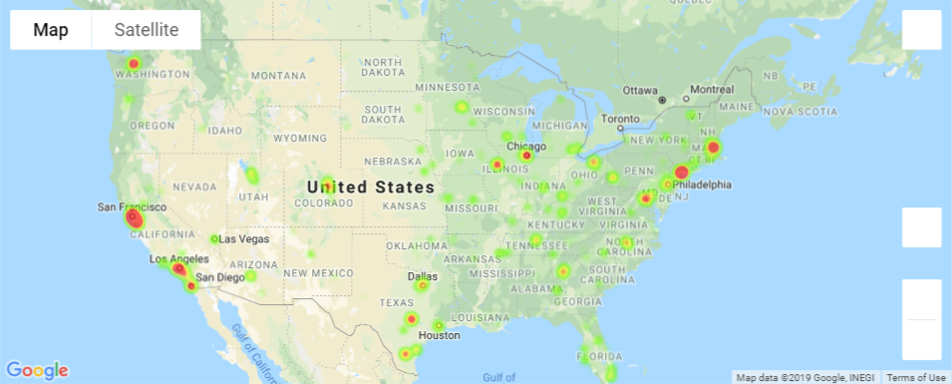
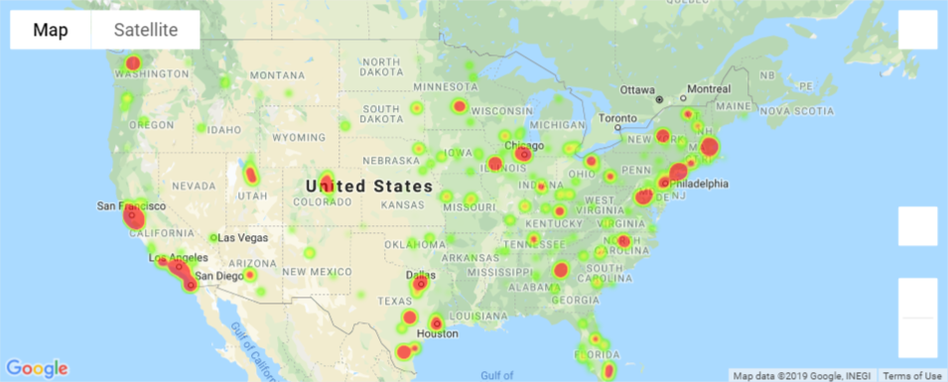
Plot of count of companies vs. funding amounts
Count of companies by city
We have observed high concentration of companies in NY and CA, however total funding is more apparent in other states such as Colorado, Texas, Illinois, Washington and Florida.
Total funding by city
7
Notes:
Macro view of where the companies and funding are. This is a good visual of where are the companies, and where is the funding?

Slide 8
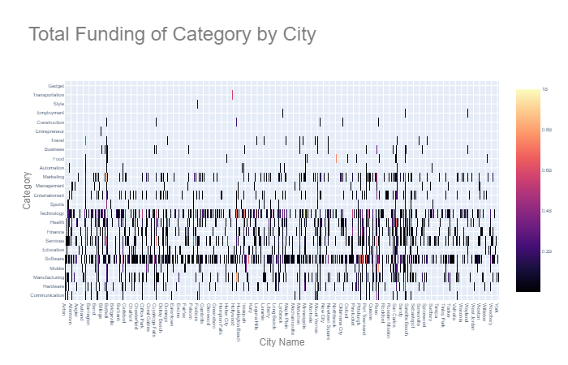
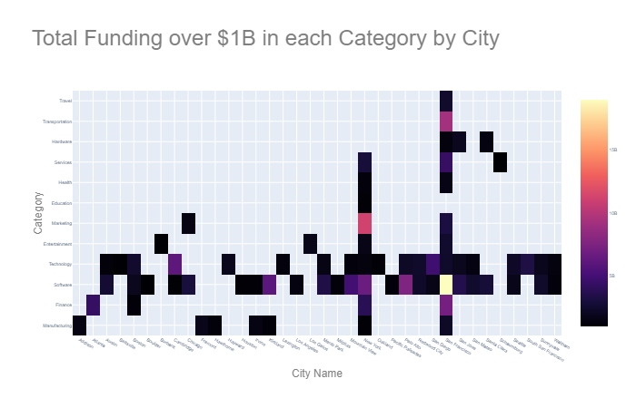

Total Funding by Category by City
We have observed trends within the technology and software category as popular across all states. Additionally some states seemed to be popular across many categories. When we focused further to total category funding >$1B, we see New York and San Francisco as the most popular cities and technology as well as software coming into greater focus. Marketing in NY and Software/Transportation in San Francisco are the highest funded.
8
Notes:
Diving deeper into the details, we plotted the data in a heatmap to see if we can see any trends. At the macro level, 2 categories: Technology and Software are apparent across most of the cities. When we zoom in, by filtering out category funding of under $1B, we can see these trends more clearly. NY and SanFran are also very popular across all categories.
Marketing/Software in NY
Finance/Software/Transportation in San Fran. Finance was interesting, but is in-line with the fintechs coming out of silicon valley.
Turn over to Don

Slide 9
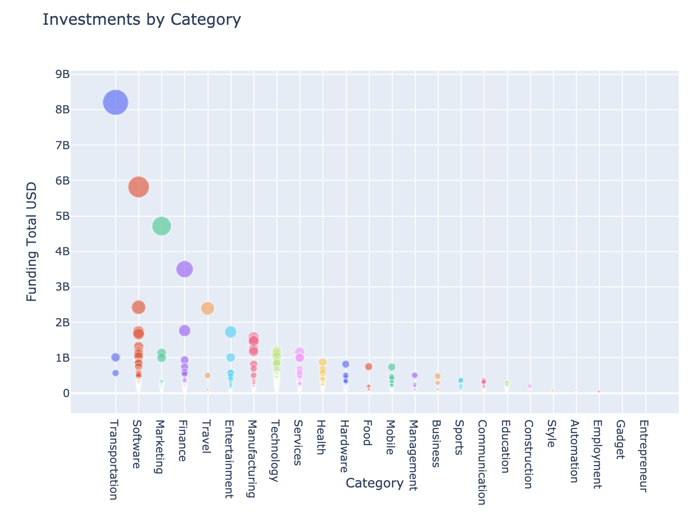
Investment by Category
We have observed that transportation, software, and marketing are the leading categories with the largest total of investments. We were surprised to see that technology came up only at the eighth-most invested category overall.
9
Notes:
Don to cover

Slide 10
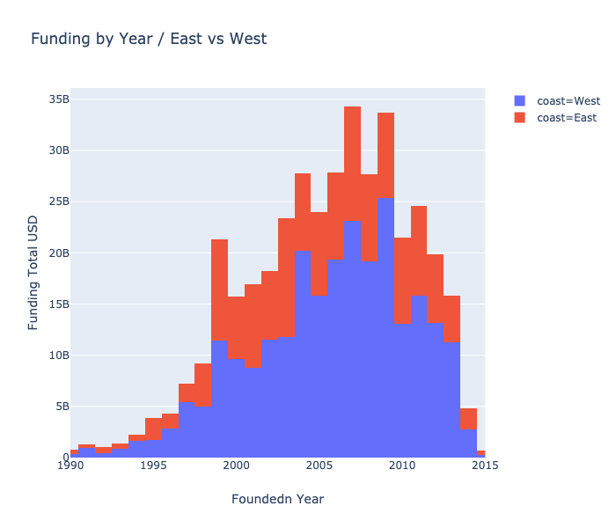
Funding by Year – East vs. West
We have observed that the east dominates throughout the years, with more funding into its companies.
10

Slide 11
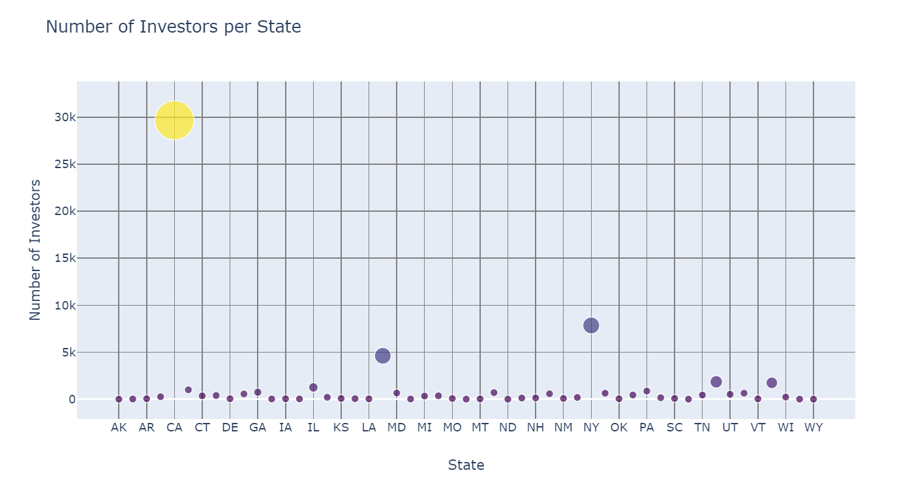
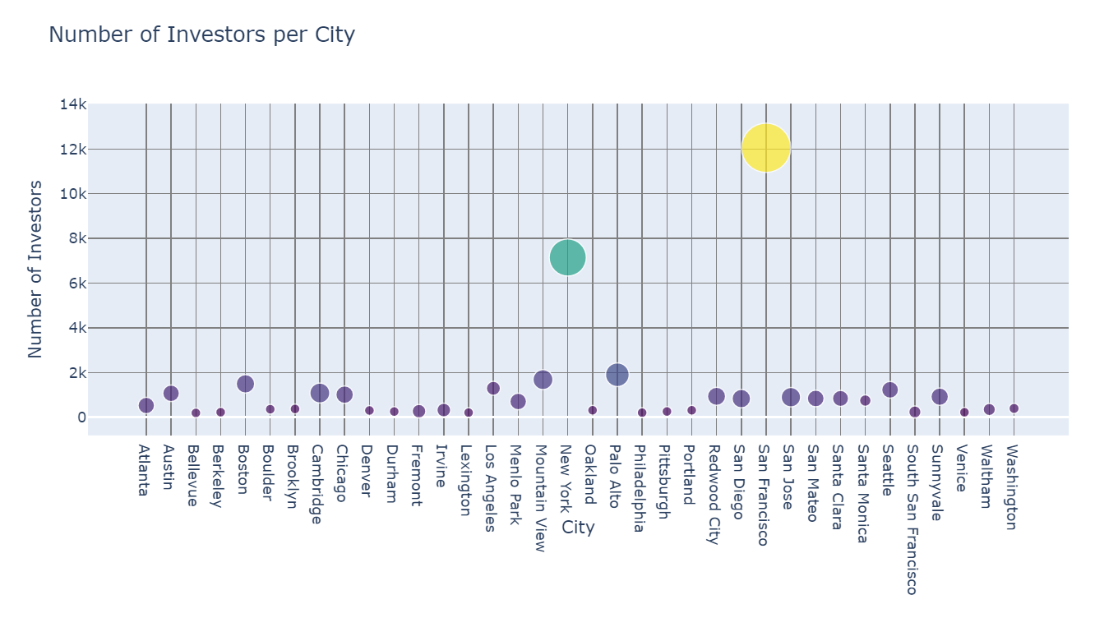
Investors: State & City
We observed that CA and NY were the primary states of companies that investors invested in
California had the top number of investors of any other state with roughly 50% of total investors
11
Notes:
Talking Points:
This plot examines the number of investors per State, with the size of the plot representing the total funding
This plot shows that California and NY have largest number of investors per state (50% and 16% respectively), following previous trends of these costal states being hotbeds for investment
Taking a deeper dive we investigate the number of investors per city, which shows that San Francisco and NY have the greatest number investors
While San Francisco has the highest number of investors by city (24%), NYC has the highest percentage of total investors in respect to its state (91%)

Slide 12
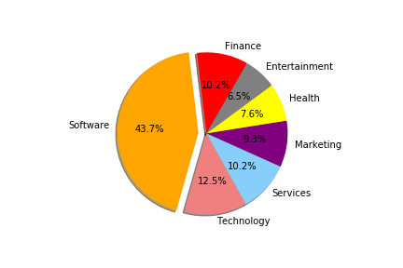
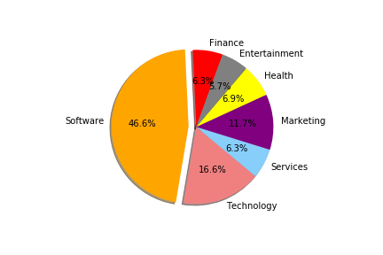
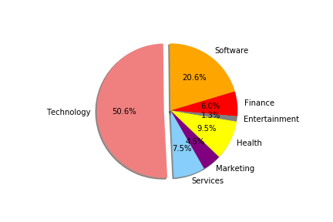
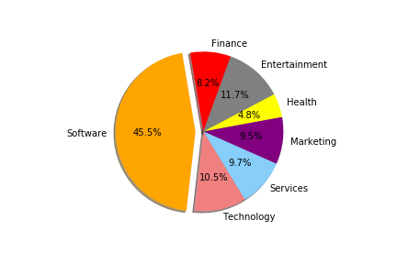
Company Status by Category
The largest category across the board is software showing its prevalence as a type of company that investors invest into
Operating
Acquired
IPO
Closed
12
Notes:
Talking Points:
These plots breakdown the 4 statuses of companies as either Operating, Acquired, IPO, or Closed and then is broken down further by the percentages of each category within this status
The prominent trend shows that software companies are the most prevalent with over 43% in 3 of the 4 categories
While Operating, Acquired and Closed show similar percentages, IPO plot shows a different story with Technology was the largest category to be taken public (IPO)

Slide 13
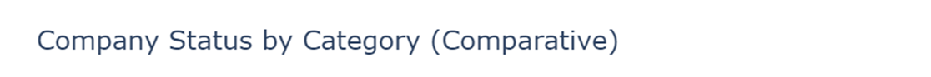
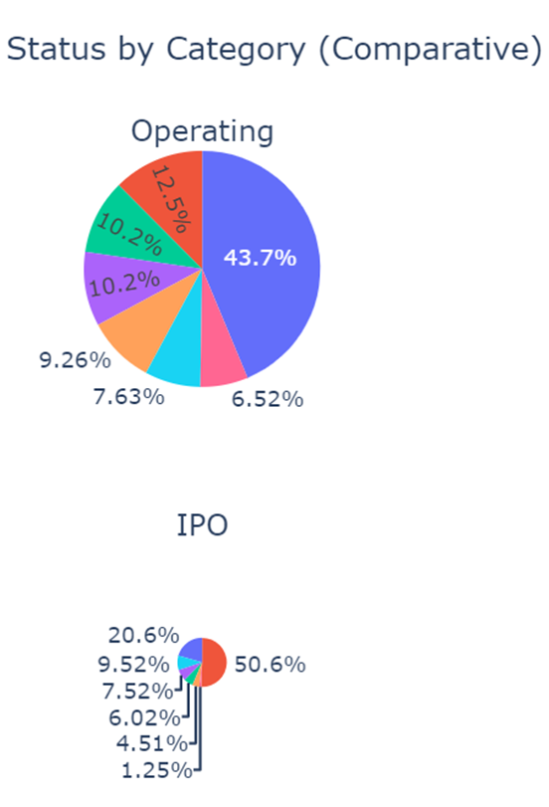
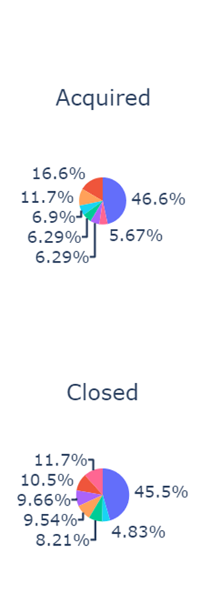
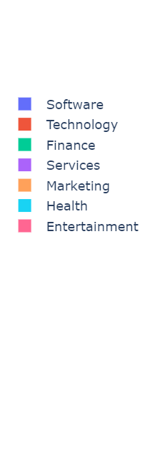
Company Status by Category (Comparative)
In comparing all operating types by respective size it becomes apparent that the company status of operating makes the largest percentage (82%) of the data set
13
Notes:
Talking Points:
This slide displays the previous pie charts with relative size to display the prominence of the status of “operating” amongst companies
82% of the companies fall into the category of “operating” while “acquired”, “ipo”, and “closed” are 5.9%, 3.5%, and 7.5% respectively
This is a good trend for investors as 92.5% of companies in this data set are still in business

Slide 14
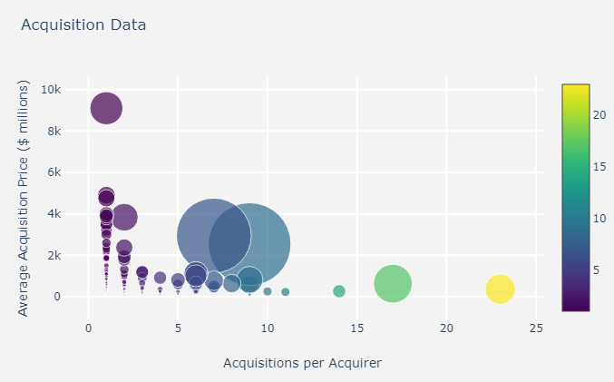
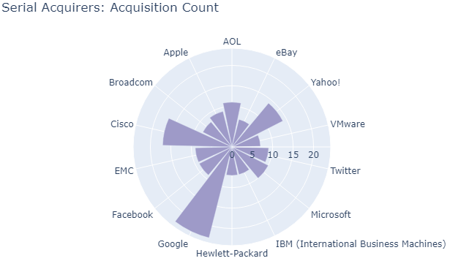
Acquisitions
There were a total of 801 (5.9%) firms acquired by 494 firms (acquirers) for a total of $334 B.
The average acquisition price for the acquired firms was $339 million (skewed by larger acquisitions).
Serial acquirers, firms that acquired 7 or more companies, spent less on average than the non-serial acquirers.
Non-serial
Serial
Count
Serial
* Bubble size reflects the total spending on acquisitions by each acquirer
14

Slide 15
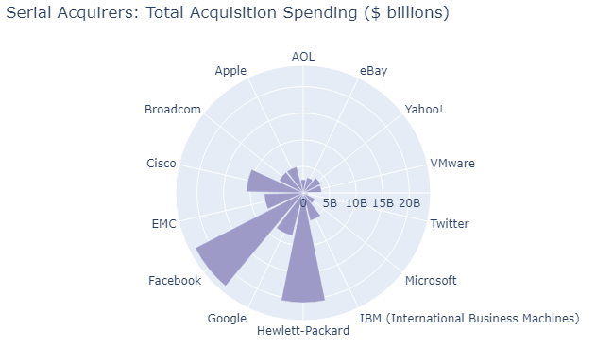
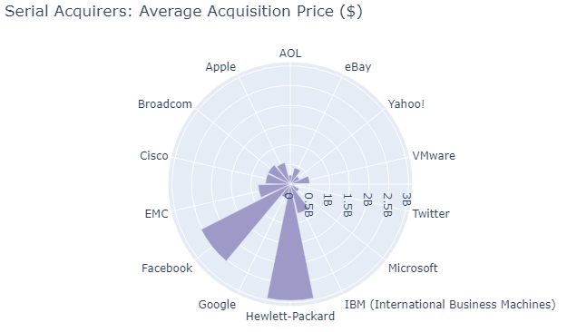
Acquisitions: Acquirers
There were a total of 14 (~3% of all acquirers) serial acquirers (acquisitions >=7), which accounted for 30% ($101 B) of total acquisition spending ($334 B).
The serial acquirers are heavily in the technology industry. While Google had the most acquisitions (23 total), Facebook (9 total) and Hewlett-Packard (7 total) were standouts for most money spent and highest average acquisition price paid.
15

Slide 16
Post Mortem
We had some limitations with the data that is available. We did reach out to CrunchBase to obtain more data, however they wanted “favors” in form of sales leads in exchange.
Aspects of the dataset from Kaggle were poorly defined, requiring lots of data cleansing and adjustments.
Potential other supplemental data to find interesting correlations, such as average income, happiness levels, etc.
Git…. Its in our name, but still challenging!
16

Slide 17


Questions?
17

Slide 18
Appendix

Slide 19
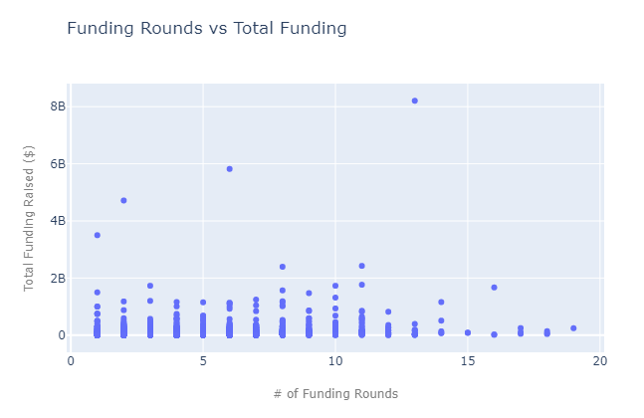
Funding Rounds
Companies in the data set received $29.6 million in total funding, over an average of 2.6 funding rounds.
Limitations of the data set prevented us from drawing any supported conclusions about round-specific funding and the relationship of # of funding rounds to total funding raised – both of which would be worth further exploration and analysis.
19

